Slide 1

S-SDLC IMPLEMENTATION IN A GAMIFIED E-LEARNING PLATFORM
End-of-Master Project
By Ismael Jiménez Castro

Slide 2
Index
Who am I?
Introduction
Theoretical Background
The Web Application S-SDLC
Implementation of the S-SDLC
Results discussion
Conclusions and future work

Slide 3
Who am I?

Slide 4

Who I am
Cybersecurity Engineer at ISDEFE (trainee)
Telematics Engineer (Universidad de Alcalá)
Master in Cybersecurity (Universidad de Alcalá)
Contact: correodeismaeljimenez@gmail.com

Slide 5
Introduction

Slide 6
Introduction
The necessity of security in software
Objectives
Motivation

Slide 7
Theoretical Background

Slide 8

State of Art
Web Applications
SDLC
S-SDLC
MS SDL

Slide 9

Security in Web Applications
Highly vulnerable according to research
Almost 100% have some sort of vulnerability
Security issues, unauthorised access, exploits, XXS...
90% of all cyber attacks
Owasp Top 10
OWASP Development Guide
Security principles that must be fulfilled when designing a web application

Slide 10
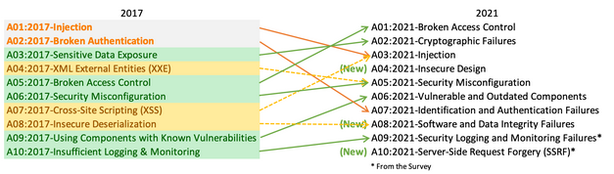
OWASP TOP 10

Slide 11
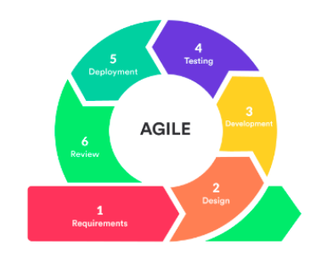

SDLC
Several approaches
Different phases:
Requirements gathering
Design of features and architecture
Coding and developing software
Testing and verification
Deployment and maintenance
Plenty of problems nowadays due to security issues

Slide 12
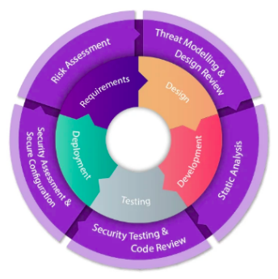
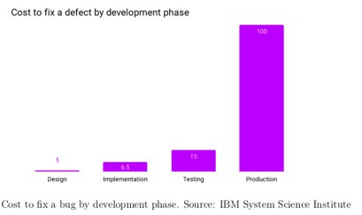
Secure SDLC
The application of security in every layer of a given SDLC
Fix problems caused by security issues in normal SDLC

Slide 13
The Web Application S-SDLC

Slide 14
My Web S-SDLC Phases
Preparation
1. Web Applications’ and Security Training
2. Requirements of the Web Application
3. Metrics definition and Compliance Reporting for the Web Application
Design
4. Threat Modeling
5. Design Requirements
6. Definition of Cryptographic Standards
7. Management the Security Risk of Third-Party Components
8. Definition of Approved Tools
Development
9. Static Analysis
Testing
Deployment and Maintenance
10.Dynamic Analysis
11. Penetration Testing
12. Safe Deployment Requirements
13. Standard Incident Response Plan

Slide 15
Implementation of the S-SDLC

Slide 16
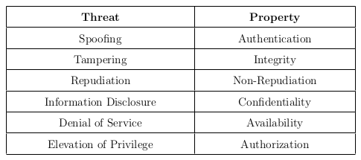
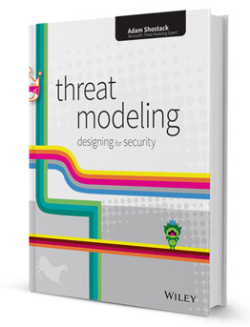
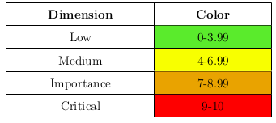
Preparation
Training and security compliance
Web Application Education
Security Education
- Importance of Threat Modeling book
Auditory
Security Requirements of the Web Application
Functional Requirements
Non-functional (security) requirements using STRIDE model
Metrics definition and Compliance Reporting

Slide 17
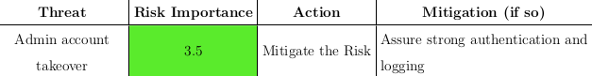


Design
Threat Modeling
Threat Model Approach
Understanding of the architecture
STRIDE Strategy to finding threats and Managing Risks
Design Requirements
Definition of Cryptographic Standards
django-cryptography library
PBKDF2
SSL (SECURE SSL REDIRECT)
Management the Security Risk of Third-Party Component
Carry out an inventory of the open souce tools used.
Perform a security analysis.
Keep open source software up to date.
Carry out a security response process.
Definition of approved tools
Source: sonarqube.org
Source: shutterstock.com

Slide 18
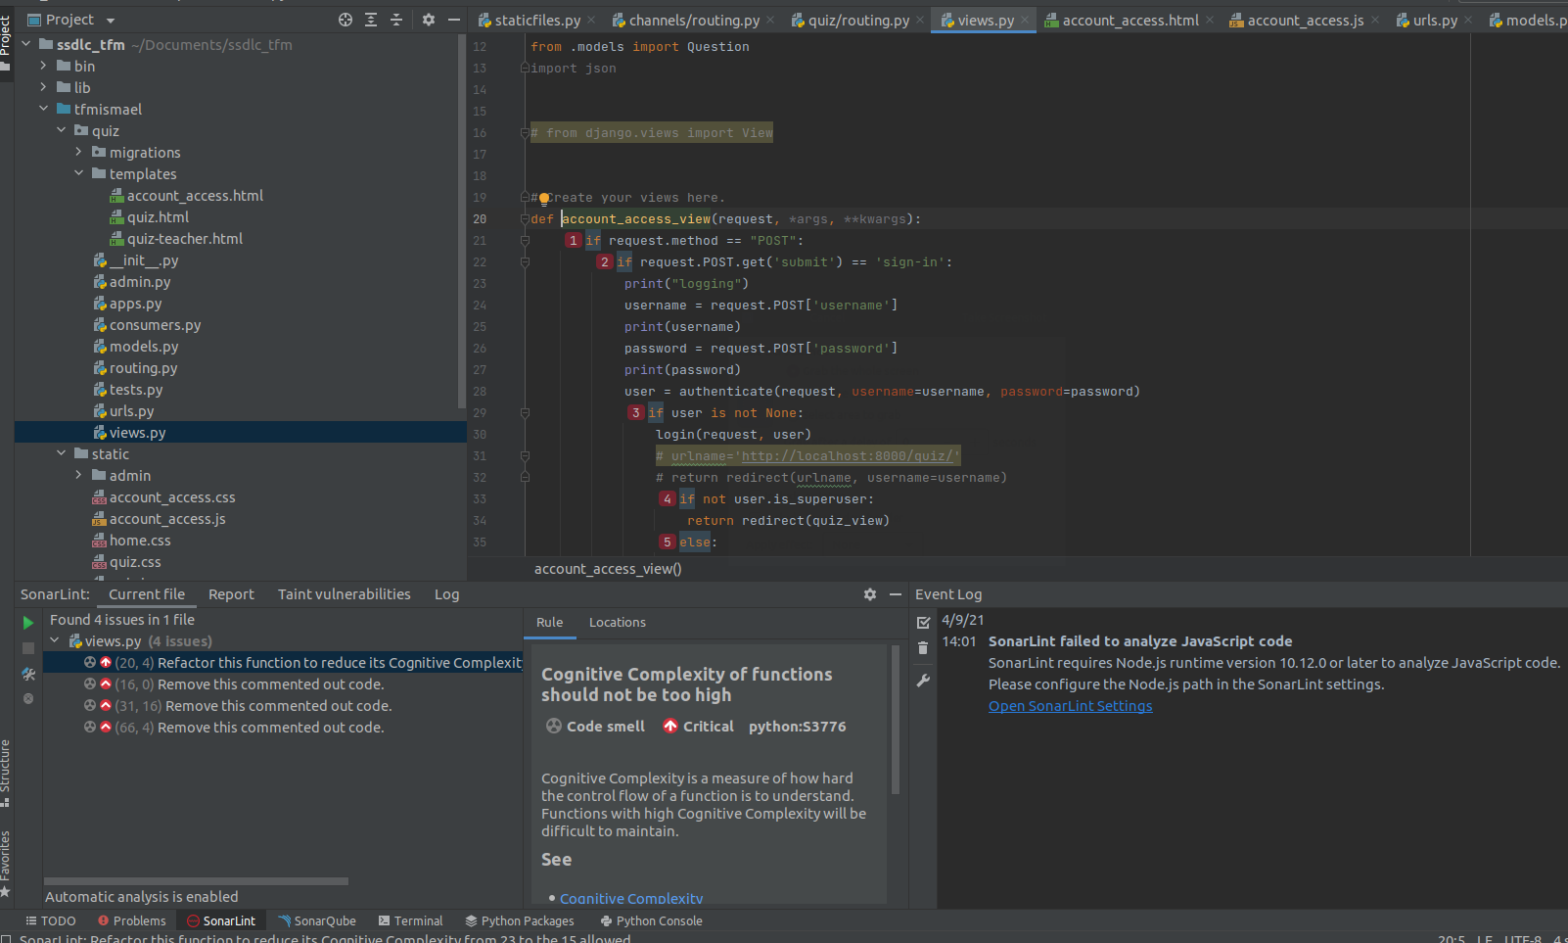
Development
New functions integrated in the application in this section
Static analysis
SonarQube, SonarLint & SonarScanner
Need to count with OpenJDK
Configurations are required
Static Analysis is not definitive!!

Slide 19


Testing
The application is already developed and testing is carried out while the web app is running.
Dynamic Analysis
OWASP ZAP
Penetration Testing
Burp Suite
Wafw00f

Slide 20
Deployment & Maintenance
Safe Deployment Requirements
A requirements.txt file.
The use of SSL and TLS to establish HTTPS
The DEBUG option of Django project must be set to False.
Code obfuscation
Use of a Web Application Firewall (WAF) to protect the web application
Establishment of a Standard Incident Response Process
An Incident Response plan or IRP.
A Business Continuity Plan or BCP.

Slide 21
Results discussion

Slide 22
Preparation results
Workers have a clear understanding of the basic concepts of cybersecurity
Important knowledge acquired of the software to be used for the web application
How to use it securely
Plenty of requirements gathered
Functional and non-functional
Proof the effectiveness of the STRIDE approach
More than 20 security requirements found
Very structured and easy to understand methodology
Common metrics defined so everyone speaks the same language
Numbers used following impact times probability formula
Colors used, each with its meaning

Slide 23
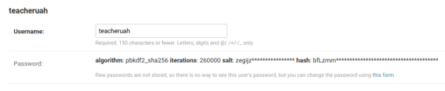
Design results
Threat Modeling very useful to thoroughly grasp the system
Importance of each components and risks to which they are exposed
Solution to the exposed threats
Applying cryptography solved many issues.
Two of them chosen to be integrated in the application:
Password hardening
Two factor authentication for the administrator’s account.
Cryptography used by Django to store passwords
Very secure

Slide 24
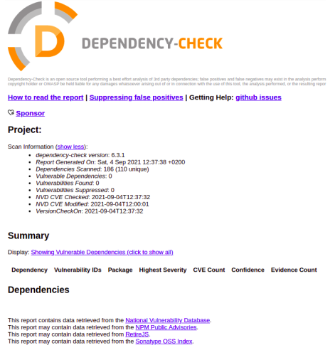
Design results (II)
Third party risks investigated using Dependency Check tool
0 vulnerabilities found after implementing the
S-SDLC.

Slide 25
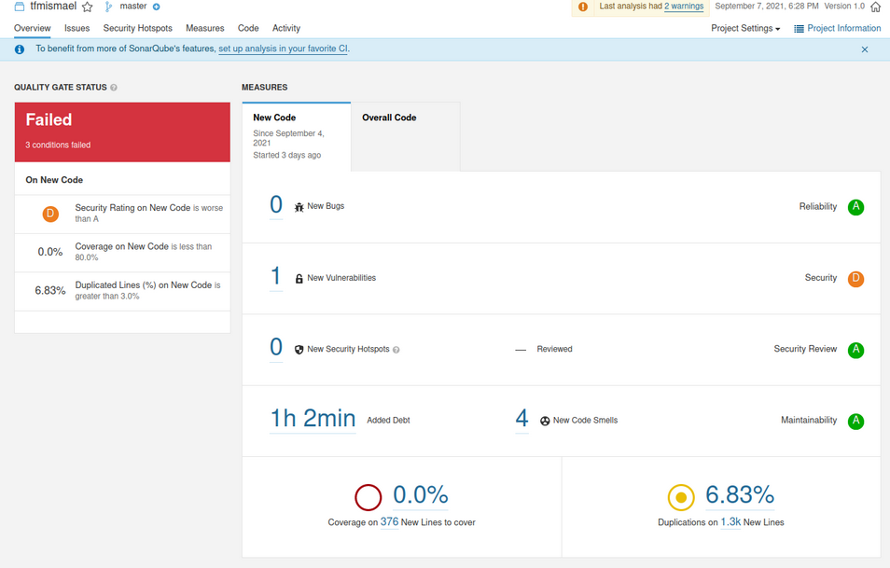
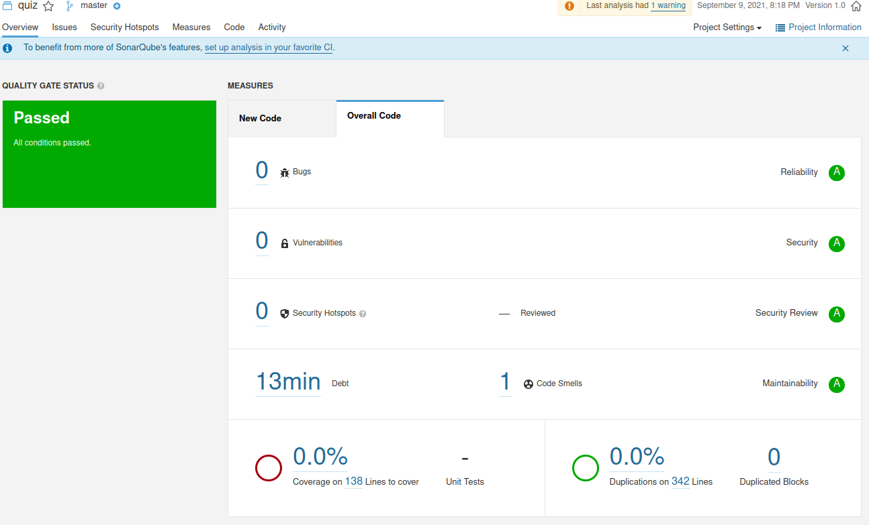
Development
This is the phase where the new functions were introduced
Coded while SonarLint and SonarQube is working
SonarScanner launched every now and then
Static analysis does help to write secure code

Slide 26
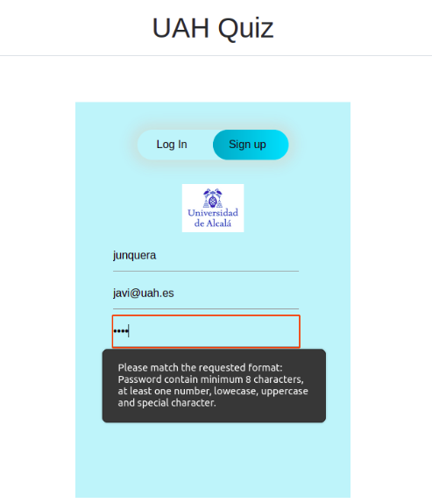
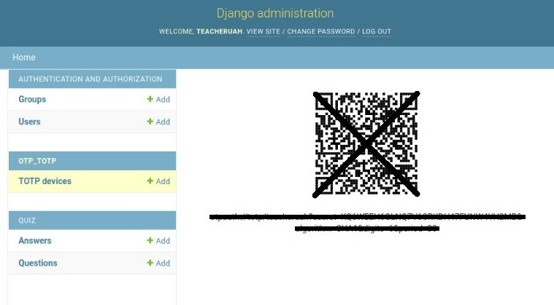
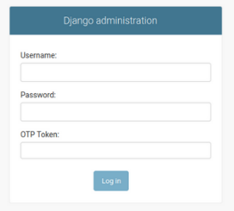
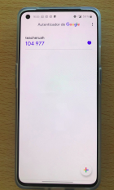
New integrated functionalities

Slide 27
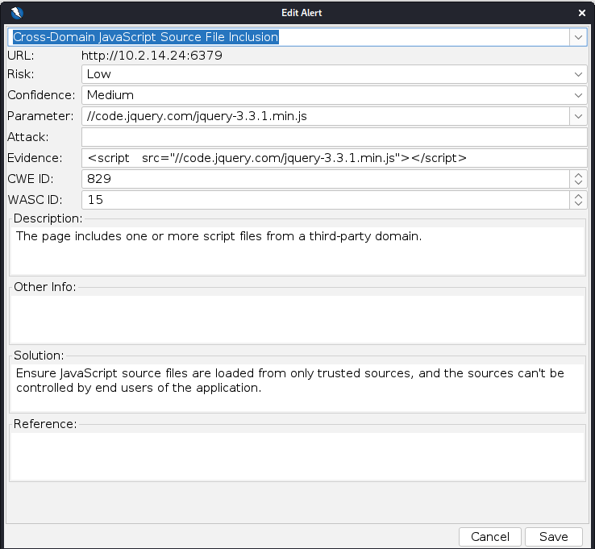
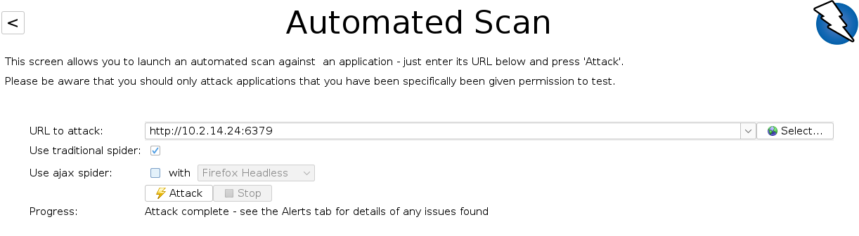
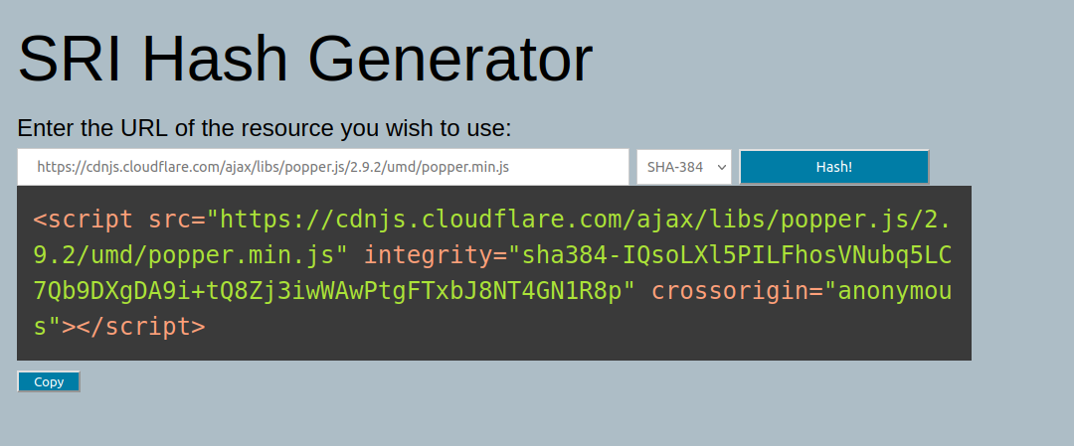
Testing
Dynamic Analysis using OWASP ZAP
Automated Scan
Vulnerabilities found regarding Information Disclosure and Integrity

Slide 28
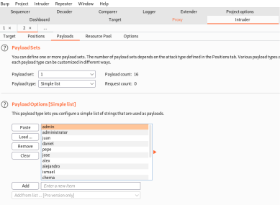
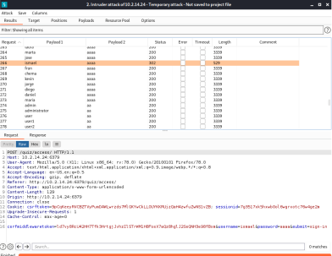
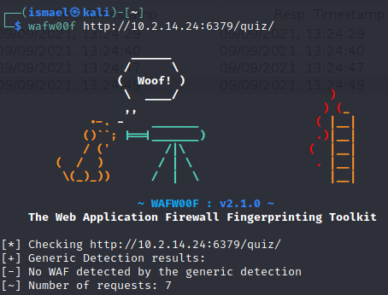
Testing
Penetration Testing
Brute Force techniques to steal credentials
Certifies the need to use strong passwords for authentication
WafW00f reveals no WAFs are used

Slide 29
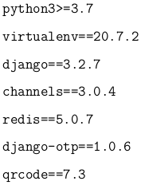
Deployment and Maintenance
Factors need to be accomplished for deployment
Impact they have in the project
Two plans achievments lead to:
A better detection, response and recovery from network security incidents
Revisions
A faster recovery of critical functions after an interruption
Caution with costs

Slide 30
Conclusions

Slide 31
Conclusions
The web application is more secure after the implementation of the S-SDLC
Security must necessarily be implemented in a S-SDLC.
Service without security makes no sense

Slide 32
Future Work
Need of implementation of SSL/TLS
Experiment with other ways to perform the S-SDLC phases
Add functionalitites to the Web Applications following the defined S-SDLC

Slide 33

Any Questions?

